Slide 1
How to Build a Chatbot — Amara Graham IBM Developer Advocate @MissAmaraKay

Slide 2
github.com/akeller/SWE-Local-Bellevue

Slide 3
Messaging Platform
Watson Assistant
Facebook Messenger
Slack
Chat portion
2. Parse Intents and Entities
3. Application decides if further action is needed
1. Capture user input
7. Return a response with dynamic data inserted into response.
3b/8. Return response back to user and wait for another user input to repeat process
6. Update context and send to Watson
Application
Third-party API
4. Make API call to get data or perform third-party action
NodeJS
Unity
Weather
5. Return dynamic data
Notes:
“Wrapper/wrapping application”
“Consuming application”

Slide 4
Guts of a Chatbot
Intents
Entities
Dialog
Context

Slide 5
#Intents
An intent is the goal or purpose of the user’s input.
Notes:
An intent is a purpose or goal expressed in a customer's input, such as answering a question or processing a bill payment.

Slide 6
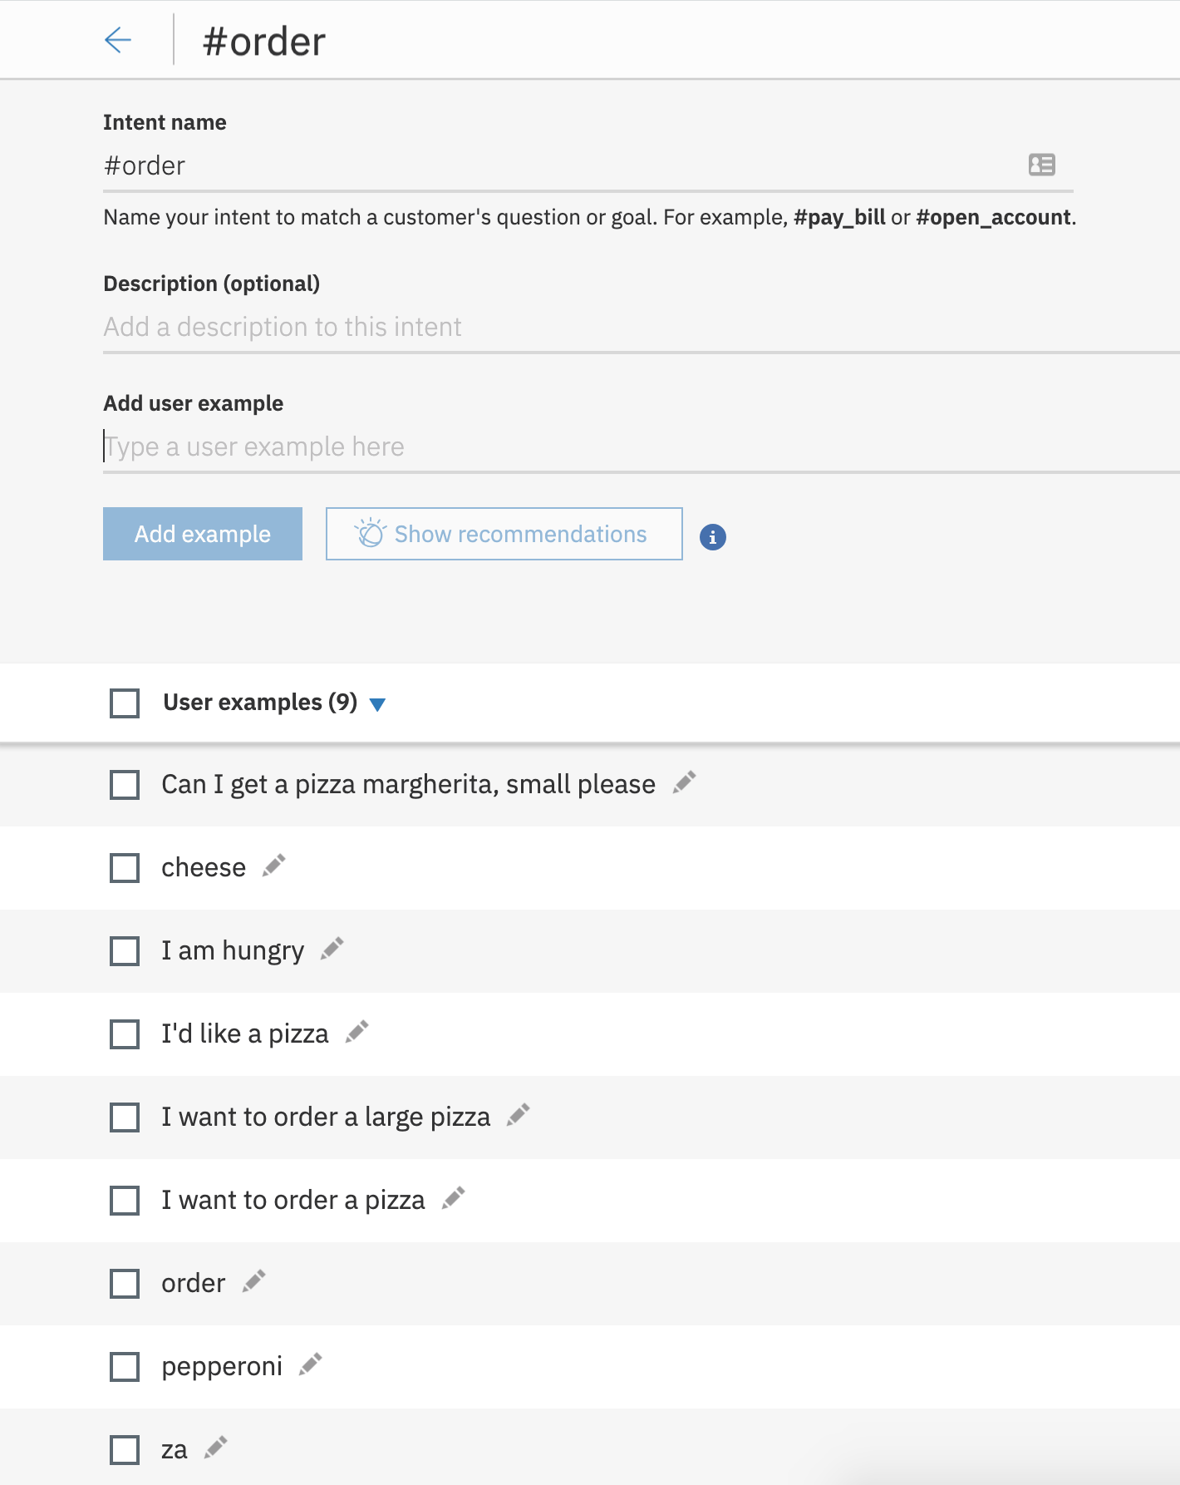
Provide at least five examples for each intent.

Slide 7
@Entities
An entity is a portion of the user’s input that you can use to provide a different response to a particular intent.
Notes:
An entity represents a class of object or a data type that is relevant to a user's purpose. By recognizing the entities that are mentioned in the user's input, the Conversation service can choose the specific actions to take to fulfill an intent.

Slide 8
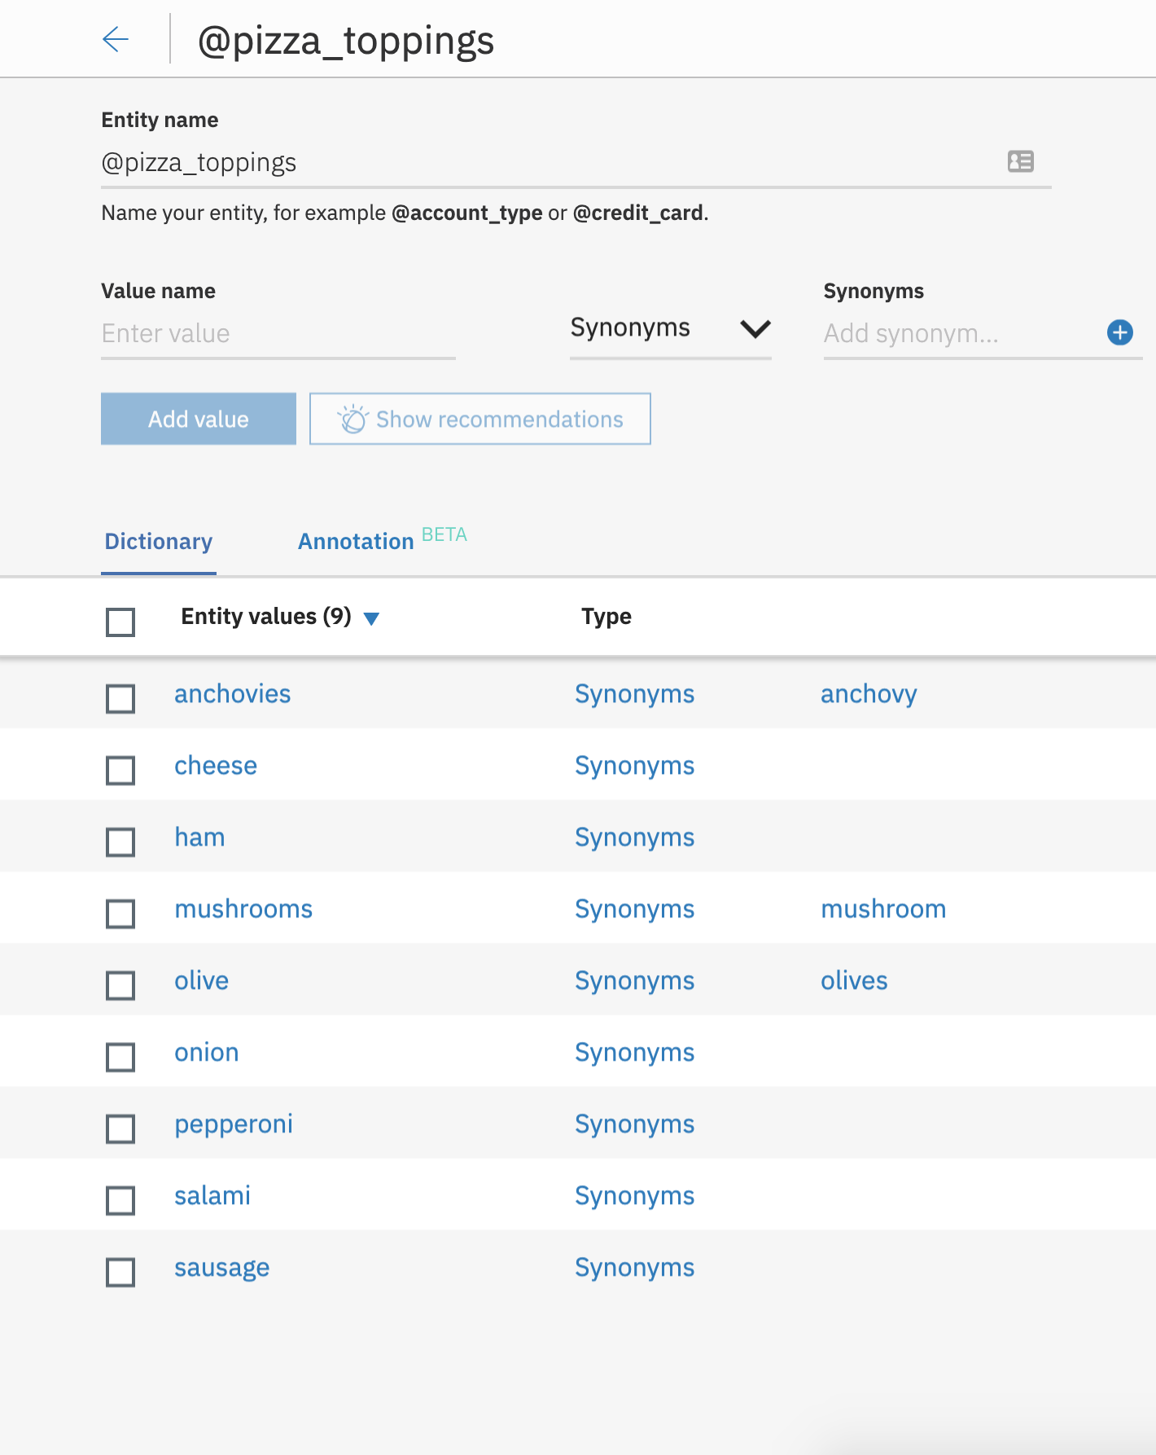
Can use synonyms or regular expressions.

Slide 9
Dialog
A dialog uses intents, entities, and context from your application to return a response to each user’s input.

Slide 10
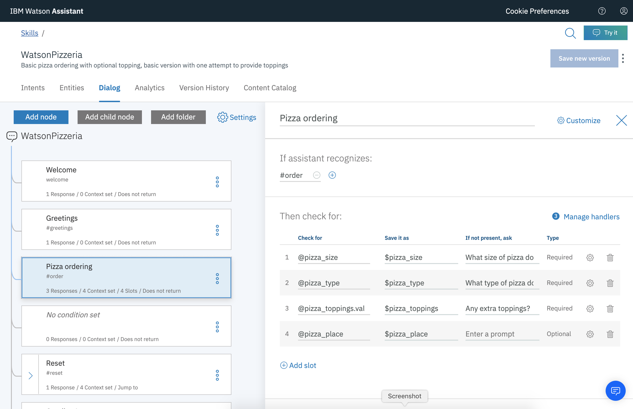

Slide 11
$context
Context keeps Watson aware of what has taken place in the conversation.
Notes:
Watson is inherently stupid without context. Watson is stateless.

Slide 12
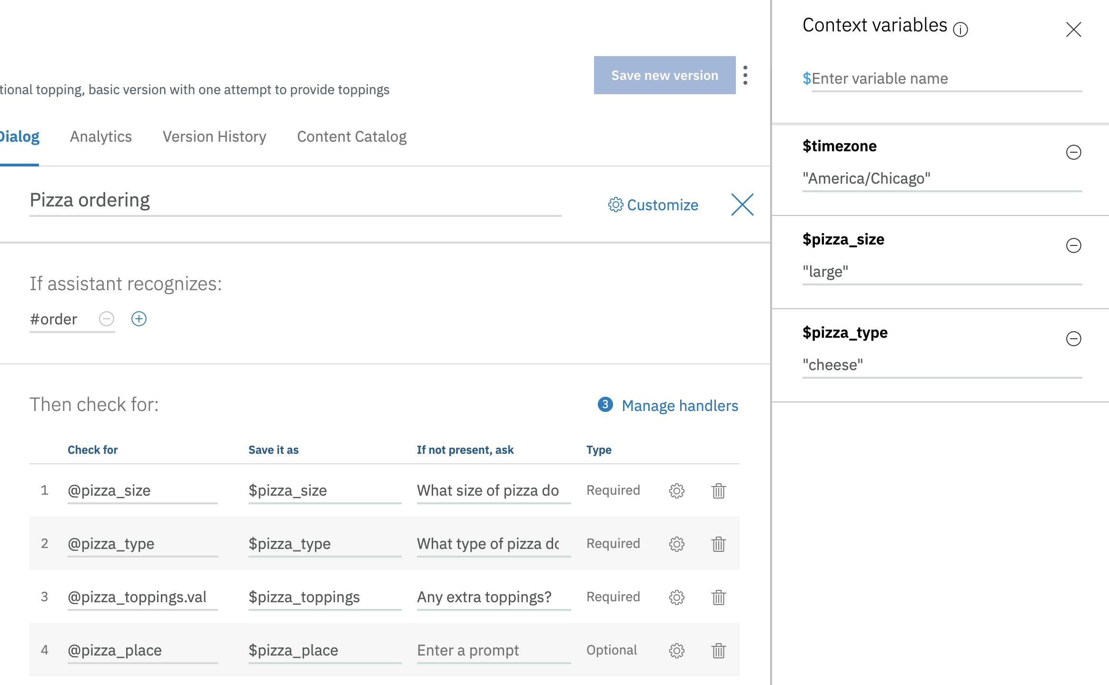

Slide 13
DEMO!

Slide 14
Additional Links
IBM Cloud
ibm.biz/SWELocal19
Pizza Ordering Chatbot ibm.biz/pizzachatbot
Cognitive Banking Chatbot ibm.biz/bankingchatbot
Bot Asset Exchange
developer.ibm.com/code/exchanges/bots/

Slide 15
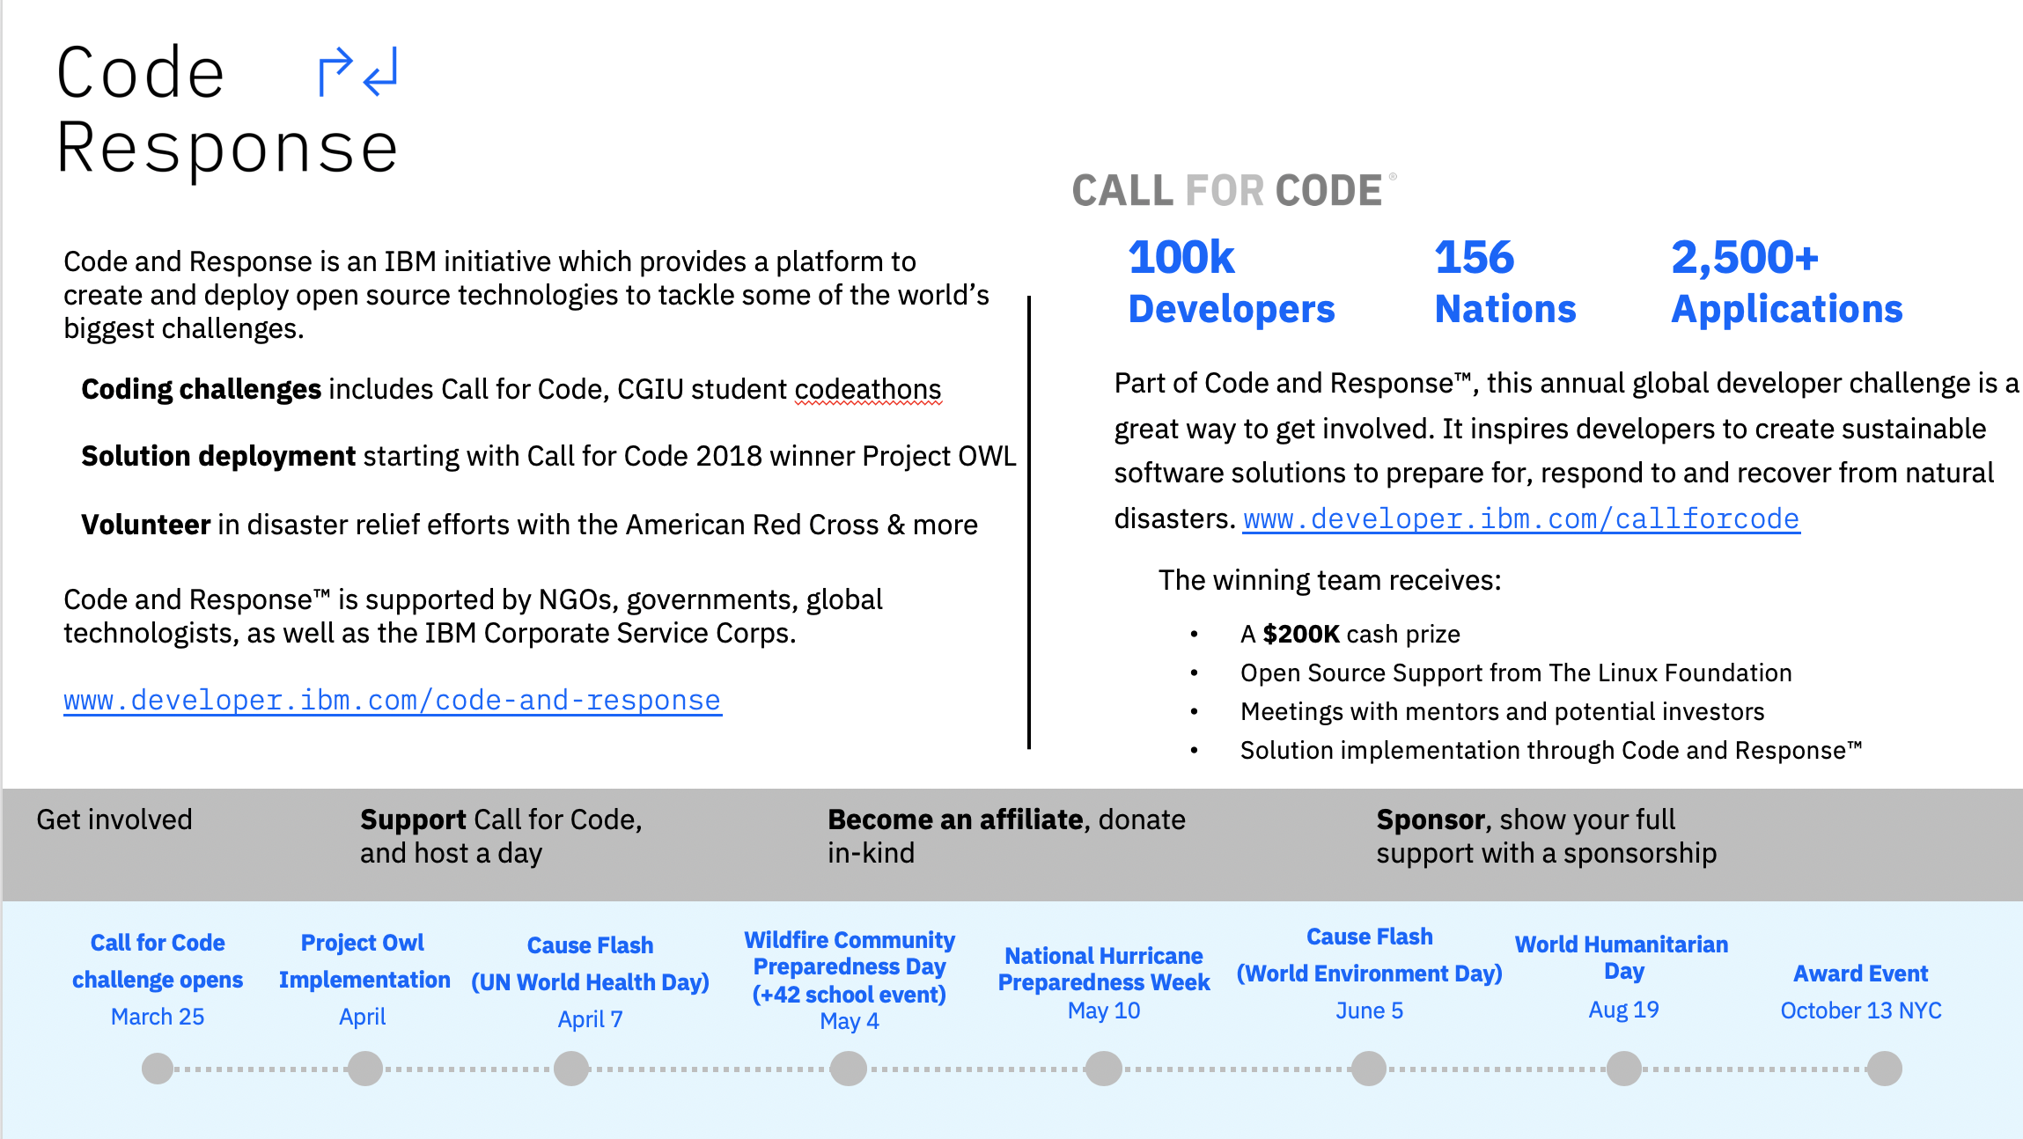
Notes:
Code and Response
IBM announced the C&R initiative at our flagship event in San Francisco in February. Our CEO and Chairman, Ginni Rometty announced this as part of her keynote to open the conference.
Over the next four years IBM is investing to provide a platform for inspiring tech for good, specifically addressing the challenges faced when a natural disaster occurs.
This platform will create and deploy open source technologies in communities where they are needed most, to tackle some of the world’s biggest challenges. Because of our history with Open Source communities, we are uniquely positioned to work alongside ecosystem partners to actively host and maintain solutions with the key communities, in particular The Linux Foundation is partnering with us on the coding challenges to ensure sustainable, quality projects. (This is a differentiator for our challenges in C&R compared to the challenges out there).
So what is C&R? It is made up of 3 parts, which when combined deliver the social impact needed to make a difference in the world by putting technology first.
Coding challenges
Solution deployment
Volunteer programs
IBM is uniquely positioned to work with the American Red Cross, CGI U and others to provide the resources to build, fortify, test, and implement solutions at scale.
Natural Disasters today are becoming more and more prevalent:
800,000+ worldwide deaths attributed to earthquakes since 2010
25% coastline areas that met or surpassed record number of flood days
800+ confirmed tornadoes touched down in 2018
17 million acres lost to wildfire in the United States in the last 2 years
22 named storms in the Eastern Pacific region this year – a record
18 volcanos considered a “very high threat” in the U.S. alone
Next steps today: Call for Code
CFC established itself as the world’s biggest coding challenge with 100k developers taking part. In 2019, we are building on this success with a particular focus on Health and Wellbeing. As part of the code and response initiative this is the primary coding challenge for developers. Offering a unique opportunity to build real sustainable apps with various inspiring rewards.
To remind you of what happened in 2018 and how much of an impact developers around the world had on mitigating natural disasters through Call for Code…1 Winner: Project OWL (keeping first responders and victims connected in a natural disaster used. The technology used is IoT solution integrates IBM Watson Studio, Watson Cloud APIs, and Weather Company APIs – all built on the IBM Cloud).
This is the largest developer challenge delivered participation from 156 Nations, with 100k+ Developers
2,500+ Applications created – real, minimum viable products that were ready to be implemented.
400+ Call for Code days delivered by IBM as the founding partner. In 4 months IBM gave 100 events a month, which is more than 3 events per day, 7 days a week somewhere around the world
Even the celebrity world got involved, from Justin Beiber to Ke$ha via Ellen Degeneres, Trevor Noah and Pierce Brosnan – they all committed to raising awareness of the challenge. 40+ Celebrity supporters
Starting on 25 March you have 4 months to get your winning solution submitted. The timeline here shows where and what you can get involved in.
We’re calling on developers to create practical, effective, and high-quality applications based on the latest technology that can have both an immediate and lasting impact.
As an organization get involved, There are many ways to contribute. You can contribute in-kind with your time, financially or with your technology. Or perhaps host a Call for Code day with your developers that not only provides positive engagement to your staff by committing to social impact, it also provides them with an occasion to build of their skills in a tech for good initiative.
www.developer.ibm.com/callforcode

Slide 16
Thank you
Amara Graham
Developer Advocate
—
amara.graham@ibm.com
@MissAmaraKay

